Slide 1
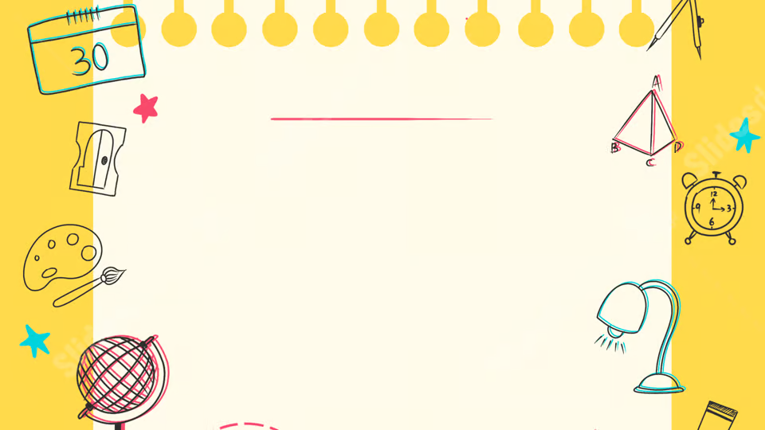
How to use AI Effectively
By Kit Horwood
(Week 3)

Slide 2

Learning Intentions:
Week 3:
What AI should be used for
How to craft an AI input prompt

Slide 3

Good AI Use
In lesson 1, you learnt a lot about the drawbacks of AI.
This week, you will learn about how to correctly use AI.

Slide 4

What to use AI for:
You should use AI to help you think, not think for you
Some teachers / assignments may have specific requirements, Always make sure to follow these first

Slide 5
Examples:
What do you think about each of these prompts?
What are some interesting facts about ancient Egypt?

Slide 6
Examples:
What do you think about each of these prompts?
Can you generate an image of my classmate?

Slide 7
Examples:
What do you think about each of these prompts?
Can you do my homework for me?

Slide 8
Examples:
What do you think about each of these prompts?
Can you explain fractions to me with an analogy?

Slide 9
Examples:
What do you think about each of these prompts?
Can you check the spelling of my assignment?

Slide 10
The Specifics:
AI can (generally) be used to:
Brainstorm
Plan
Understand
Analyse
Learn
AI should NOT be used to:
Do your assignments for you
Violate the privacy of others

Slide 11

Make sure to check with your teacher!

Slide 12

How to use AI:
Everyone draw a circle

Slide 13
How to use AI:
What assumptions did you have to make?
Colour
Size
Thickness
What a circle is

Slide 14

How to use AI:
Computers need exact instructions to do anything
AI is somewhat better at context, but it still benefits from specific instructions

Slide 15
Let’s try it!
Let’s do a more detailed prompt.
Draw a mountain range. There should be three main mountains, and there should be life everywhere. People, trees and animals.

Slide 16

According to Google Gemini…

Slide 17
Let’s try it!
The following slide contains a detailed artwork
I want you to re-create the artwork using AI (15 min)
Hint – Make your prompt specific and difficult to mis-interpret

Slide 18

Use AI to
Re-create
This image
Best
Re-creation
Gets a prize!
(I will check
To make sure
You haven’t
Cheated)

Slide 19
Next Week…
Next lesson, we’ll be putting everything we’ve learnt into practice!
You’ll all use AI to create a game or project yourself
Think About what you want to Create!

Slide 20
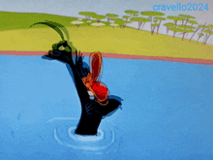
See you next week!

